Slide 1




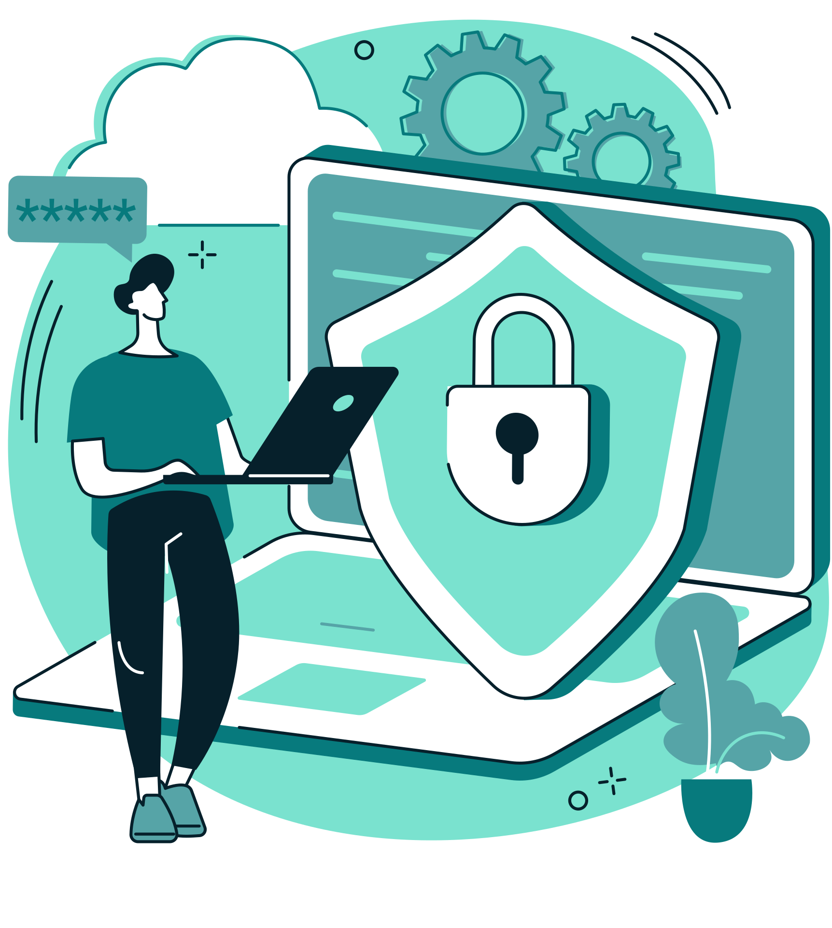
Arowwai Industries
Cybersecurity Roadmap
2025
Protect your business with a comprehensive cybersecurity strategy that safeguards assets and ensures business continuity. We'll build robust defense systems against evolving threats.

Slide 2



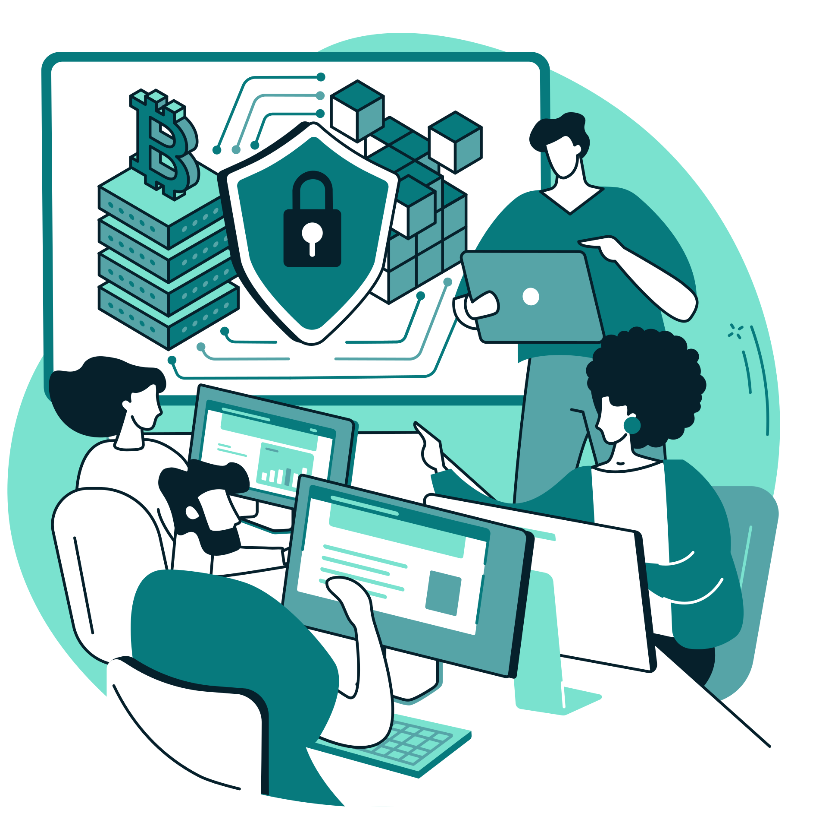

Arowwai Industries
Cybersecurity Assessment & Risk Analysis
Current security posture evaluation
Threat landscape analysis
We assess existing security measures and identify vulnerabilities in your systems
Understanding current and emerging threats that target your industry and organization
Cybersecurity Roadmap
Risk assessment and prioritization
Compliance requirement review
We identify and rank security risks based on potential impact and likelihood
Industry regulations and standards that must be met for legal and operational compliance

Slide 3


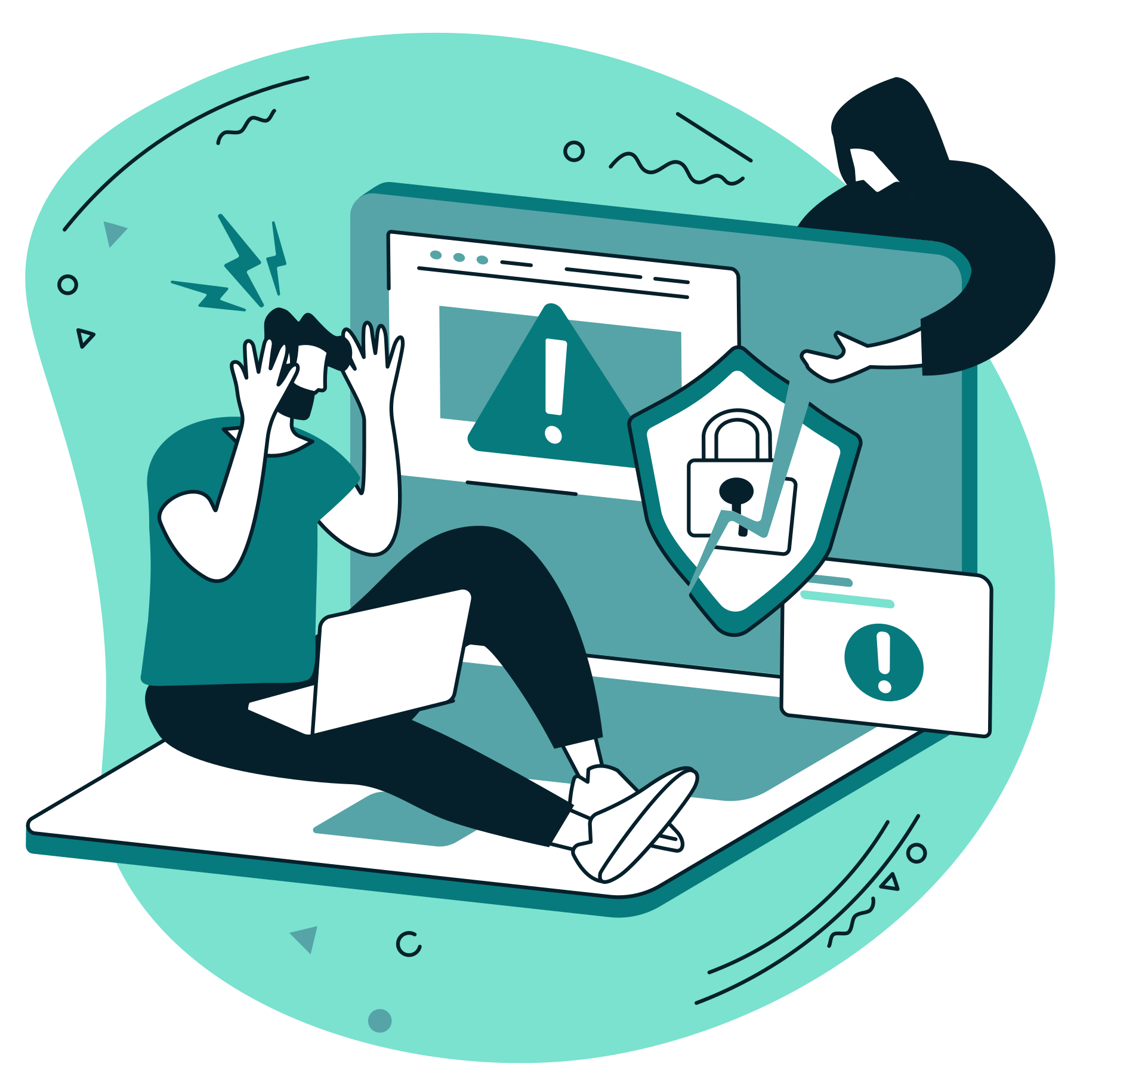


Arowwai Industries
Cybersecurity Roadmap
Security governance structure
Security Framework & Governance
We establish leadership, policies, and procedures for effective cybersecurity management
Security policy development
Comprehensive policies guide employee behavior and technology use
Compliance framework implementation
Systems and processes ensure ongoing adherence to regulatory requirements

Slide 4

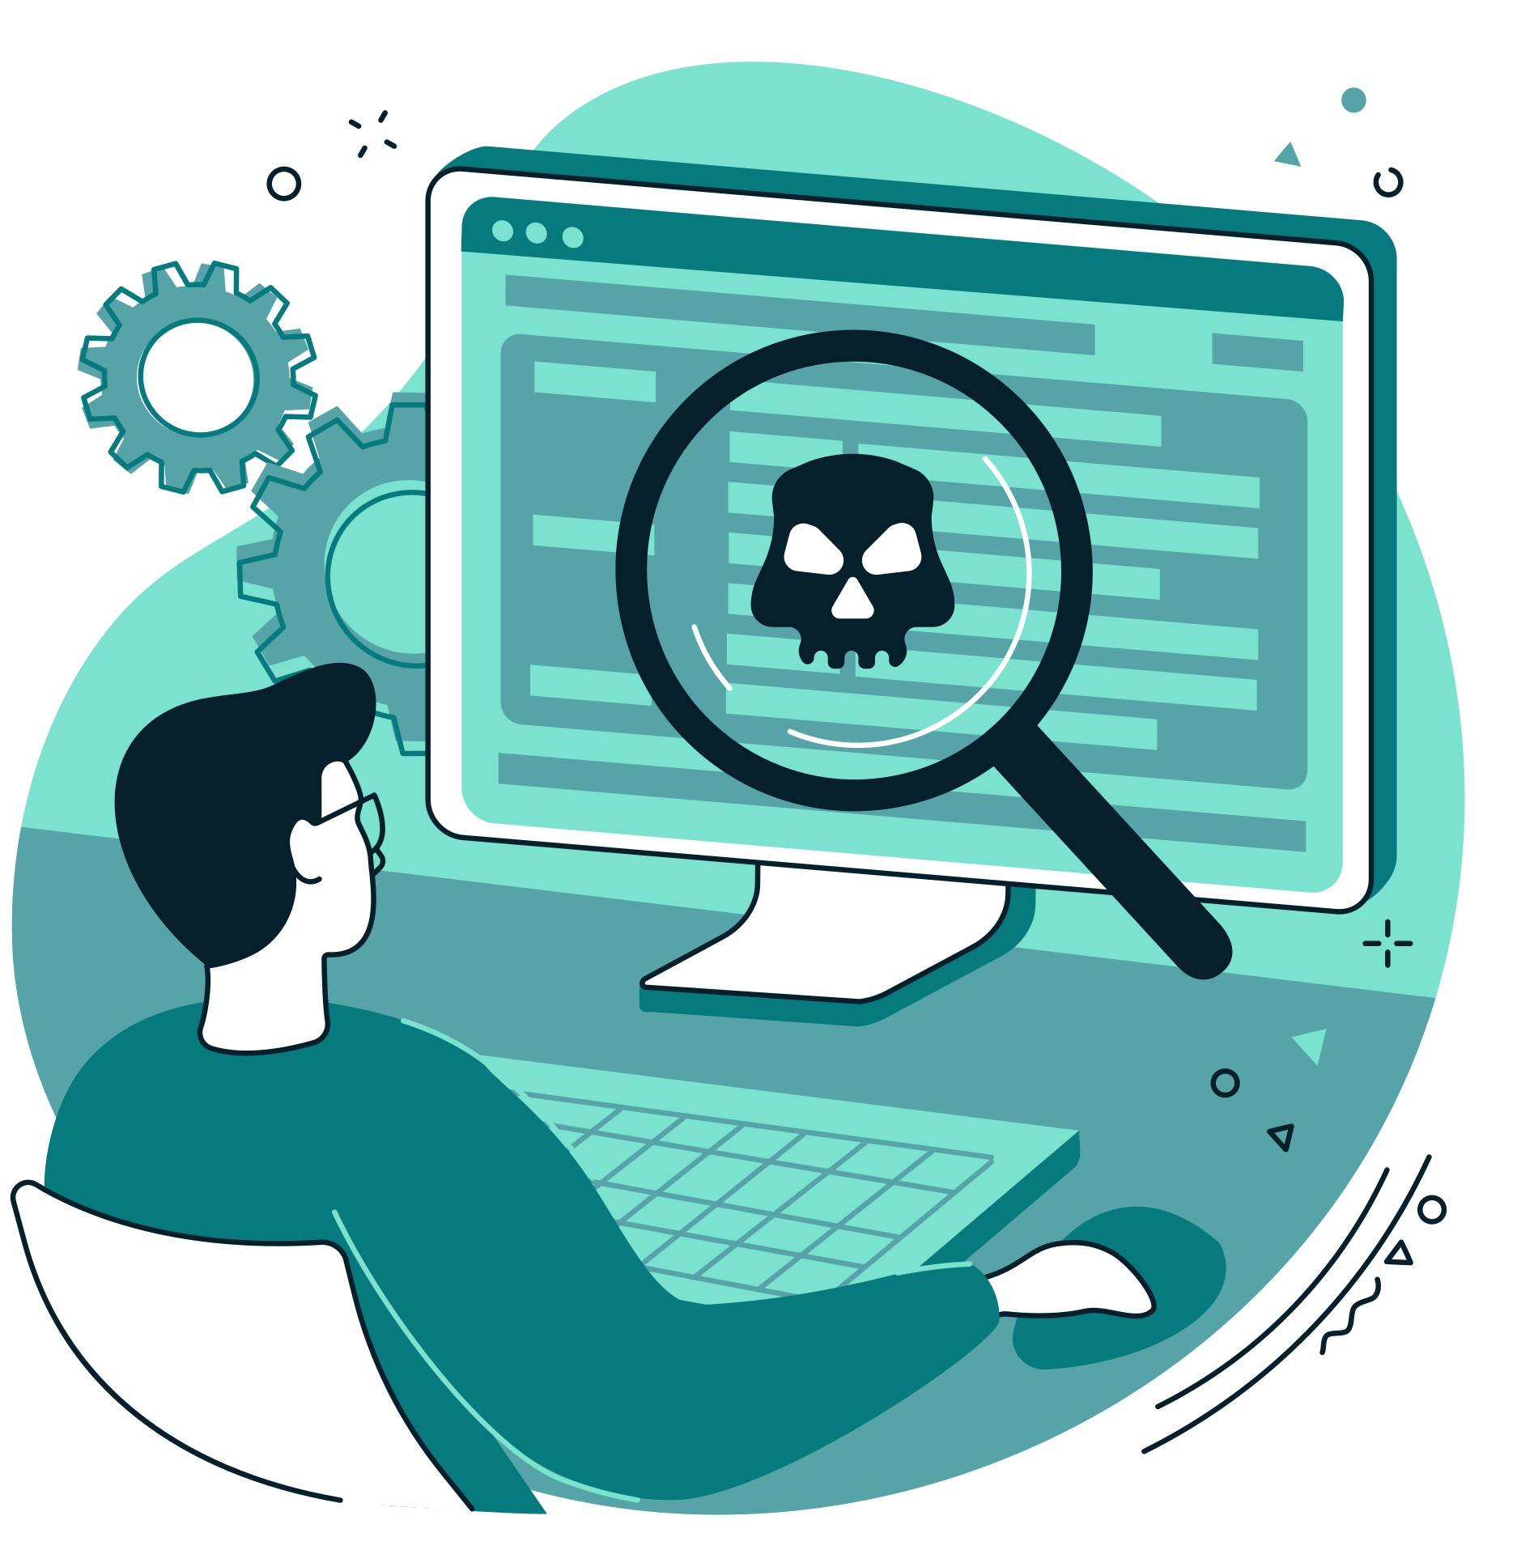



Arowwai Industries
Network Security & Infrastructure Protection
Cybersecurity Roadmap
Firewall and network security
Intrusion detection and prevention
Secure network architecture
Wireless security implementation
We implement robust perimeter defenses and network segmentation strategies
Advanced monitoring systems identify and block suspicious network activity
Network design principles that minimize attack surfaces and contain potential breaches
Wi-Fi and mobile device security that protects against unauthorized access

Slide 5




Arowwai Industries
Data Protection & Privacy
Data classification and inventory
We identify and categorize sensitive data that requires special protection measures
Cybersecurity Roadmap
Data encryption strategies
Privacy protection compliance
Comprehensive encryption protects data both at rest and in transit
Systems and procedures ensure customer and employee privacy rights are protected

Slide 6


Arowwai Industries
Identity & Access Management
Cybersecurity Roadmap
User authentication systems
Access control management
We implement multi-factor authentication and strong password policies
Role-based permissions ensure users have appropriate access to systems and data
Privileged access management
Identity monitoring and auditing
Special controls protect administrative accounts and high-value system access
Regular review ensures access permissions remain appropriate and secure

Slide 7




Arowwai Industries
Cybersecurity Roadmap
Endpoint & Device Security
Endpoint protection deployment
Mobile device management
Software patch management
We secure computers, mobile devices, and other endpoints against malware and attacks
Policies and tools protect business data on personal and corporate devices
Systematic updates ensure systems remain protected against known vulnerabilities

Slide 8


Arowwai Industries
Incident response plan development
We create detailed procedures for responding to security breaches and cyber attacks
Security monitoring and alerting
24/7 monitoring systems detect and alert on potential security incidents
Backup and disaster recovery
Comprehensive data protection ensures business continuity after security incidents
Incident Response & Recovery
Forensic investigation capabilities
Tools and processes for analyzing security incidents and preventing future attacks
Cybersecurity Roadmap

Slide 9

Arowwai Industries
Security Training & Awareness
Cybersecurity Roadmap
Employee security training
Phishing and social engineering defense
Security culture development
We educate staff on security best practices and threat recognition
Training programs help employees identify and respond to manipulation attempts
Organization-wide commitment to security as everyone's responsibility

Slide 10
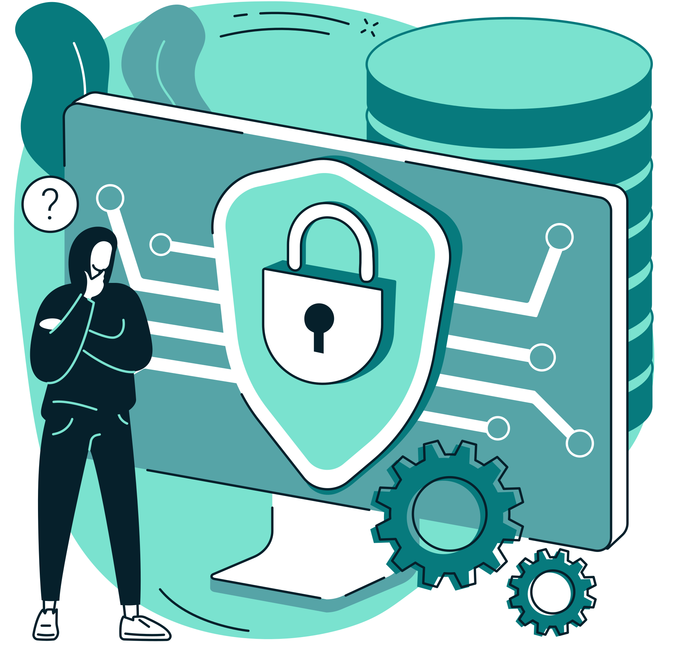



Arowwai Industries
Cybersecurity Maturity & Evolution
Cybersecurity Roadmap
Security maturity assessment
Threat intelligence integration
Cybersecurity transformation roadmap
We evaluate and improve your organization's cybersecurity capabilities over time
Continuous monitoring of emerging threats keeps defenses current and effective
Your security journey begins with implementing these fundamental protection strategies

Slide 11








Resource Page

